Slide 2
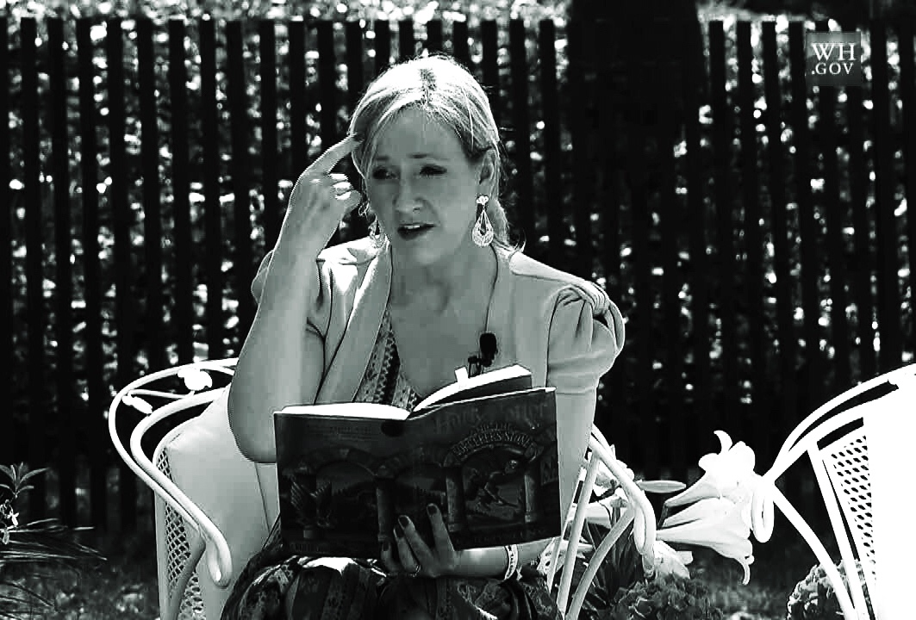
(c) Wikipedia / public domain

Slide 3
If you want to present yourself or your firm, or to motivate your team, this J. K. Rowling inspired Presentation Structure (7 slides) offers storytelling at it's best. Start with a true event that changed your/ your firm's perspective and enlarge it including the dreams and hopes of your audience. Why - How - What. That's the right sequence!
You can inflate every step with more slides, but try to avoid it. Remember: Presenting is an art and art is all about quality, not quantity.
Story of Turning Point
New Vision & Mission
Importance for Audience
Obstacles Encountered
Call for Joint Action
Presentation of Firm/ Team/ Person
More on www.robertolalli.com

Slide 4
1. Story of Turning Point Picture
"I still can remember vividly when ..."

Slide 5
2. New Vision & Mission Picture
"Suddenly I understood that ..."

Slide 6
3. Importance For Audience Picture
"Have you ever wondered ..."

Slide 7
4. Obstacles Encountered Picture
"It was not easy because ..."

Slide 8
5. Achievements So Far Picture
"It was not easy because ..."

Slide 9
6. Call for Joint Action Picture
"That is why we need your help if ..."

Slide 10
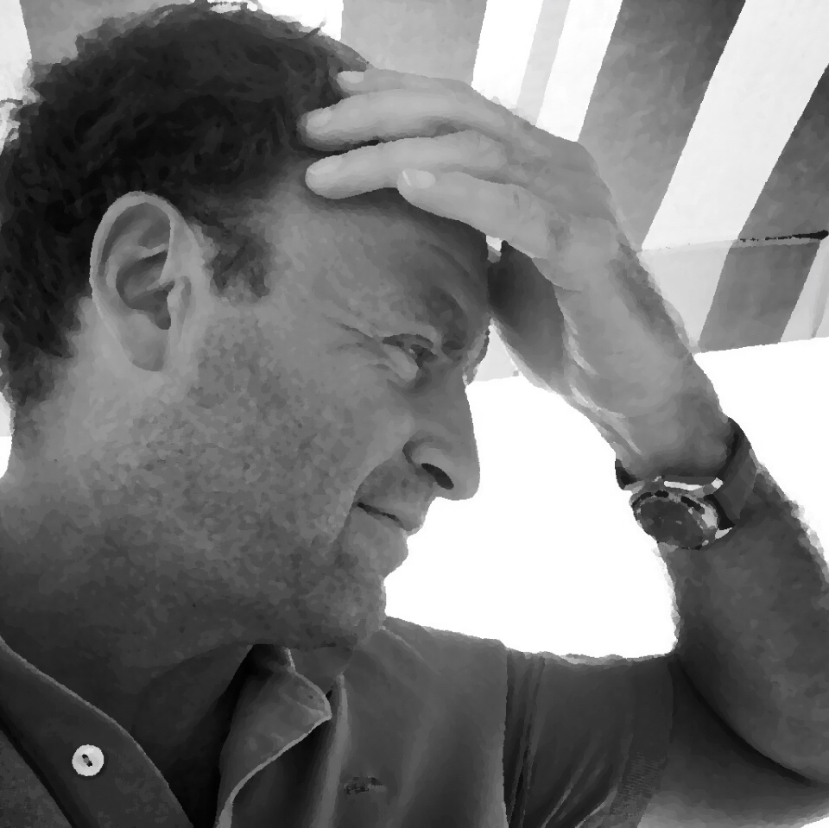
7. Presentation of Firm/ Team/ Person Picture
"And we are ..."

Slide 11
"The only way out is through."
J. K. Rowling

Slide 12
This high class
presentation advice
was brought to you by:
Become our sponsor!

