Slide 2
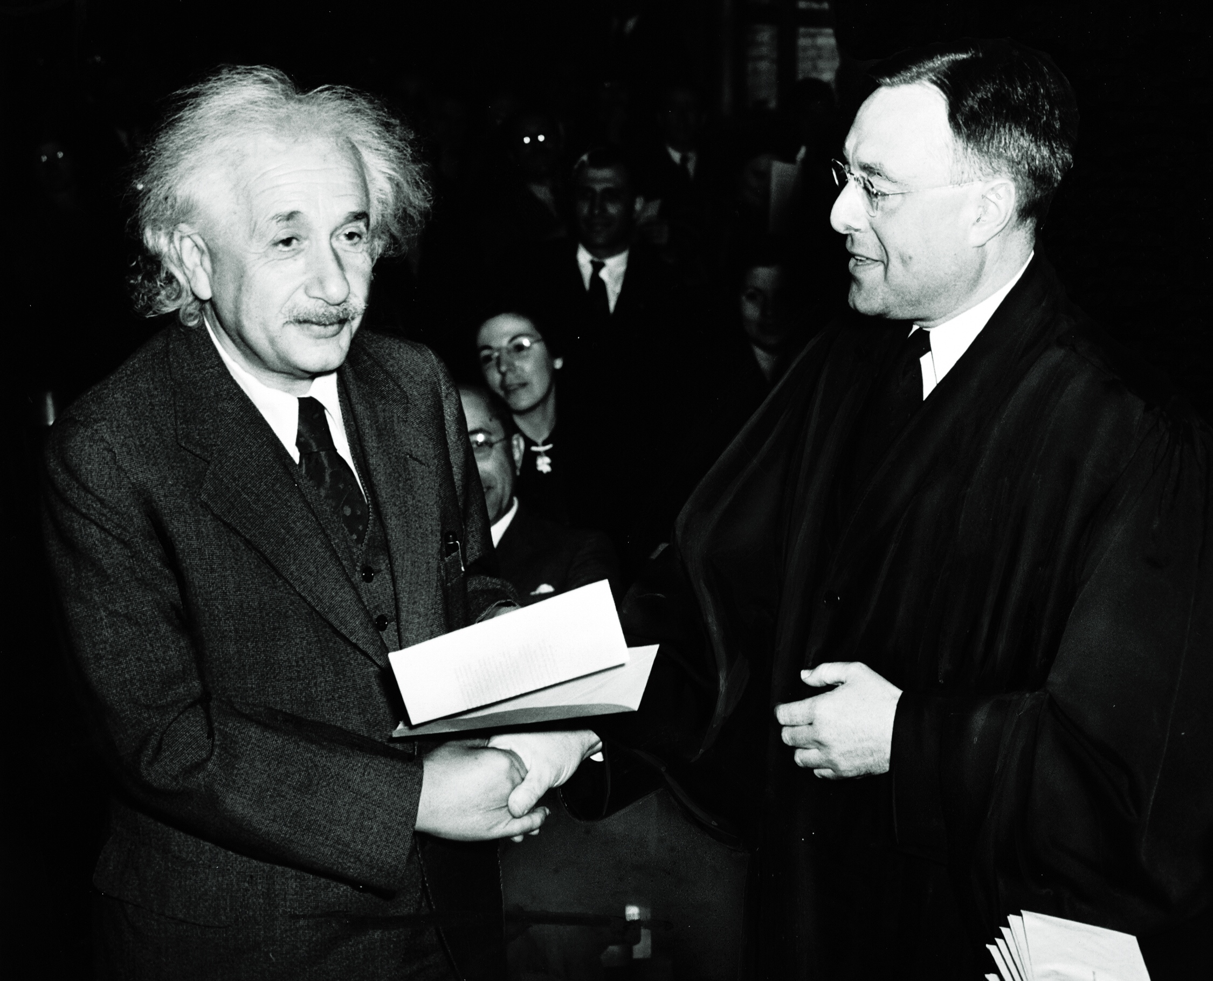
(c) Wikipedia / public domain

Slide 3
If you want to Report Data, this Albert Einstein inspired Presentation Structure (10 slides) will bring your findings to life. Remember to answer all the W-questions during the evaluation step: where, when, who, what (how much) and, most important, why.
If you want to welcome your audience do so between step 1 and step 2 (after slide 1). You can inflate every step with more slides, but try to avoid it. Remember: Presenting is an art and art is all about quality, not quantity.
Question at Hand
Approach Chosen
Evaluation of the Data
Conclusion
Recommendation
More on www.robertolalli.com

Slide 4
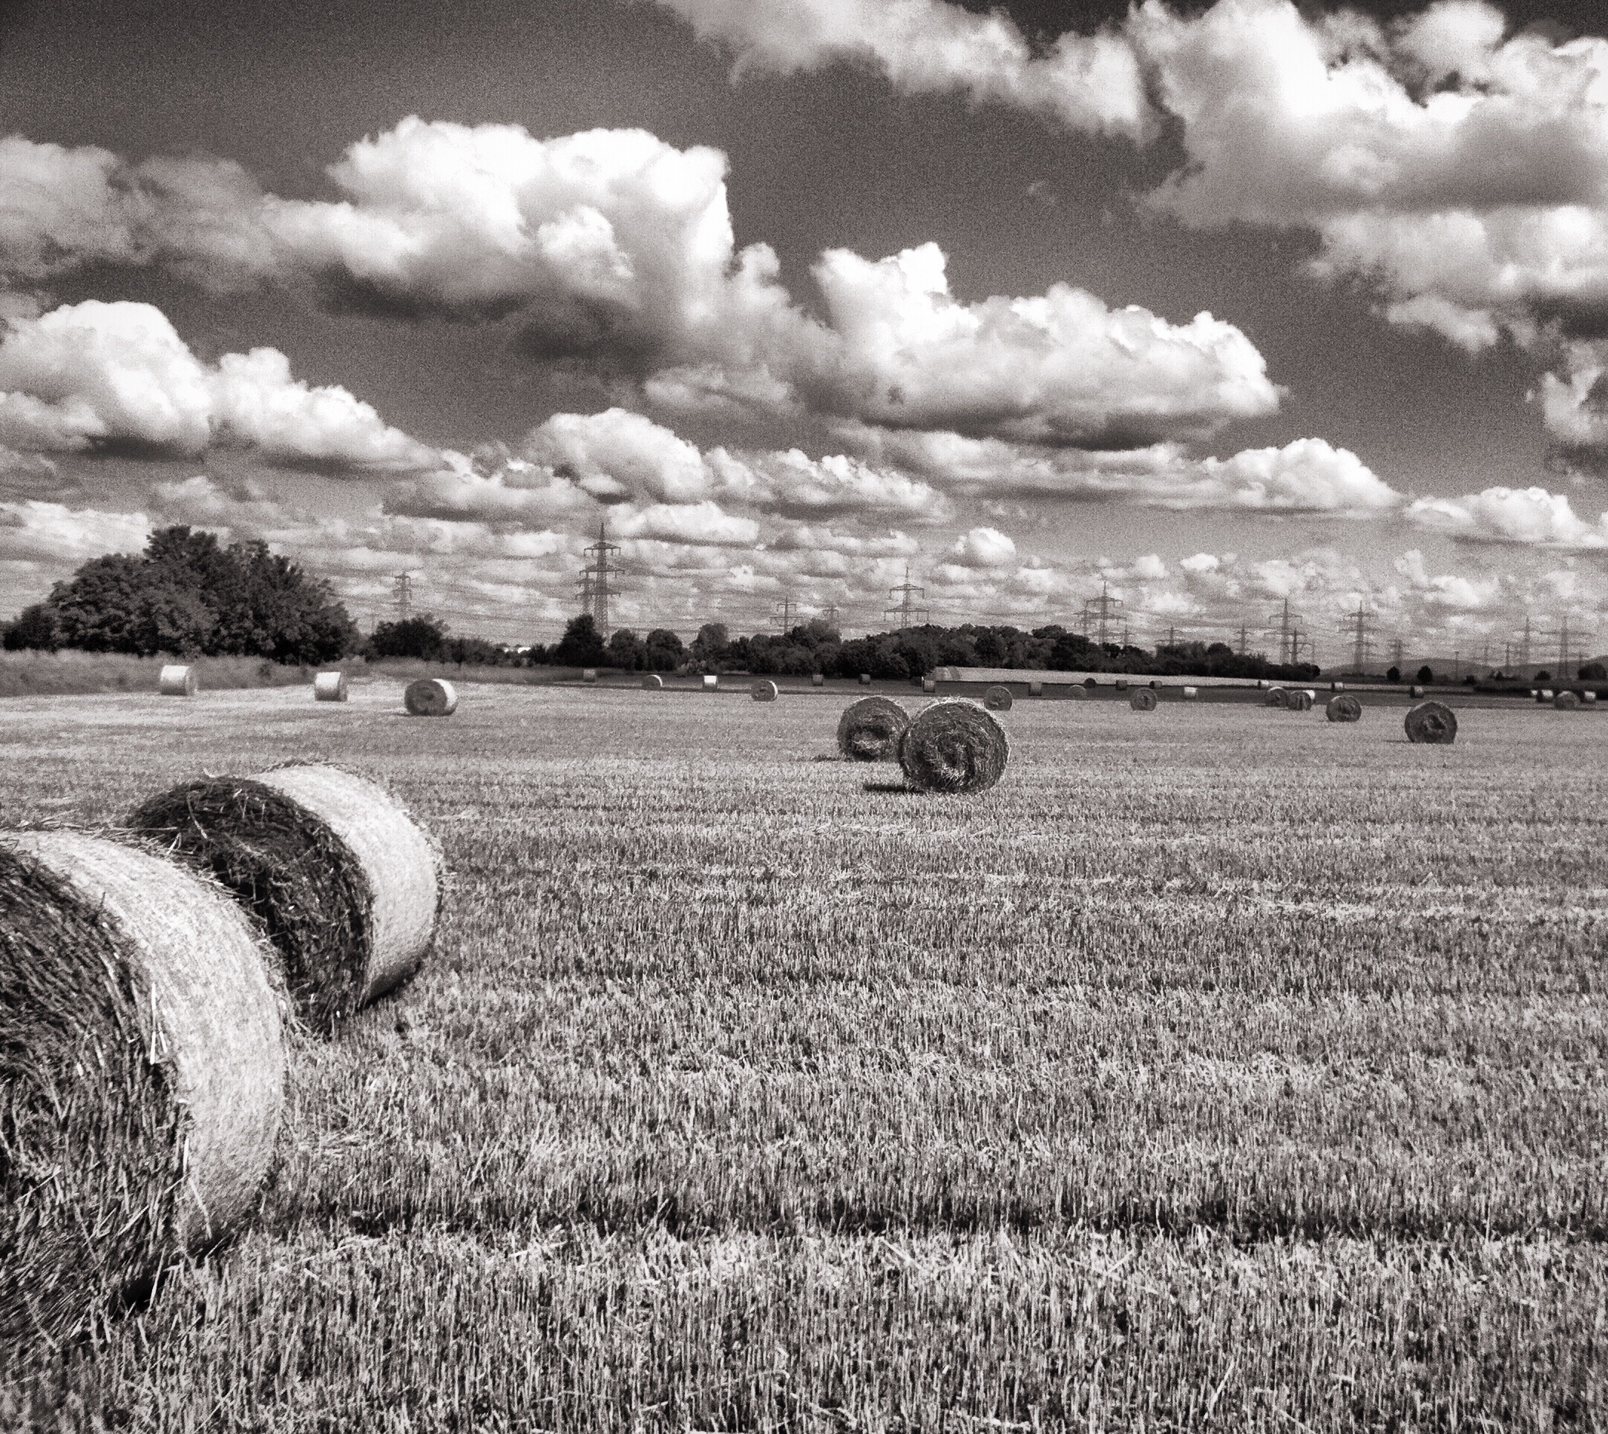
1. Question at Hand Picture
"What brought us here today is ..."

Slide 5
2. Approach Chosen Picture
"We will focus on this because ..."

Slide 6
3. Evaluation of the Data Picture
"Let's have a look at ..."

Slide 7
Evaluation Past Chart
"In the past ..."

Slide 8
Consequences Picture
"Some of us think ... I think ..."

Slide 9
Evaluation Present Chart
"Today ..."

Slide 10
Consequences Picture
"Some of us think ... I think ..."

Slide 11
Evaluation Future
"Now, all you have to do is ..."

Slide 12
Consequences Picture
"Some of us think ... I think ..."

Slide 13
4. Conclusion Picture
"As we can see the answer to our Q is ..."

Slide 14
5. Recommendation Picture
"That is why we should ..."

Slide 15
This high class
presentation advice
was brought to you by:
Become our sponsor!

