Slide 1


Slide 2
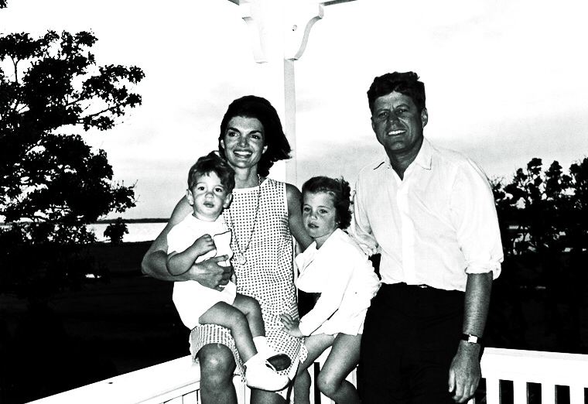
((c) Wikipedia / public domain

Slide 3
If you want to change people's beliefs and actions, this Jacqueline Kennedy inspired Presentation Structure (8 slides) will touch your audience through storytelling.
If you want to welcome your audience, do so between step 1 and step 2 (after slide 1). You can inflate every step with more slides, but try to avoid it. Remember: Presenting is an art and art is all about quality, not quantity.
My Ordinary World
Inciting Incident
Lost Balance/ Obstacles
Despair
Revelation
Rise
New Life/ Higher Balance
Lesson Learned
More on www.robertolalli.com

Slide 4
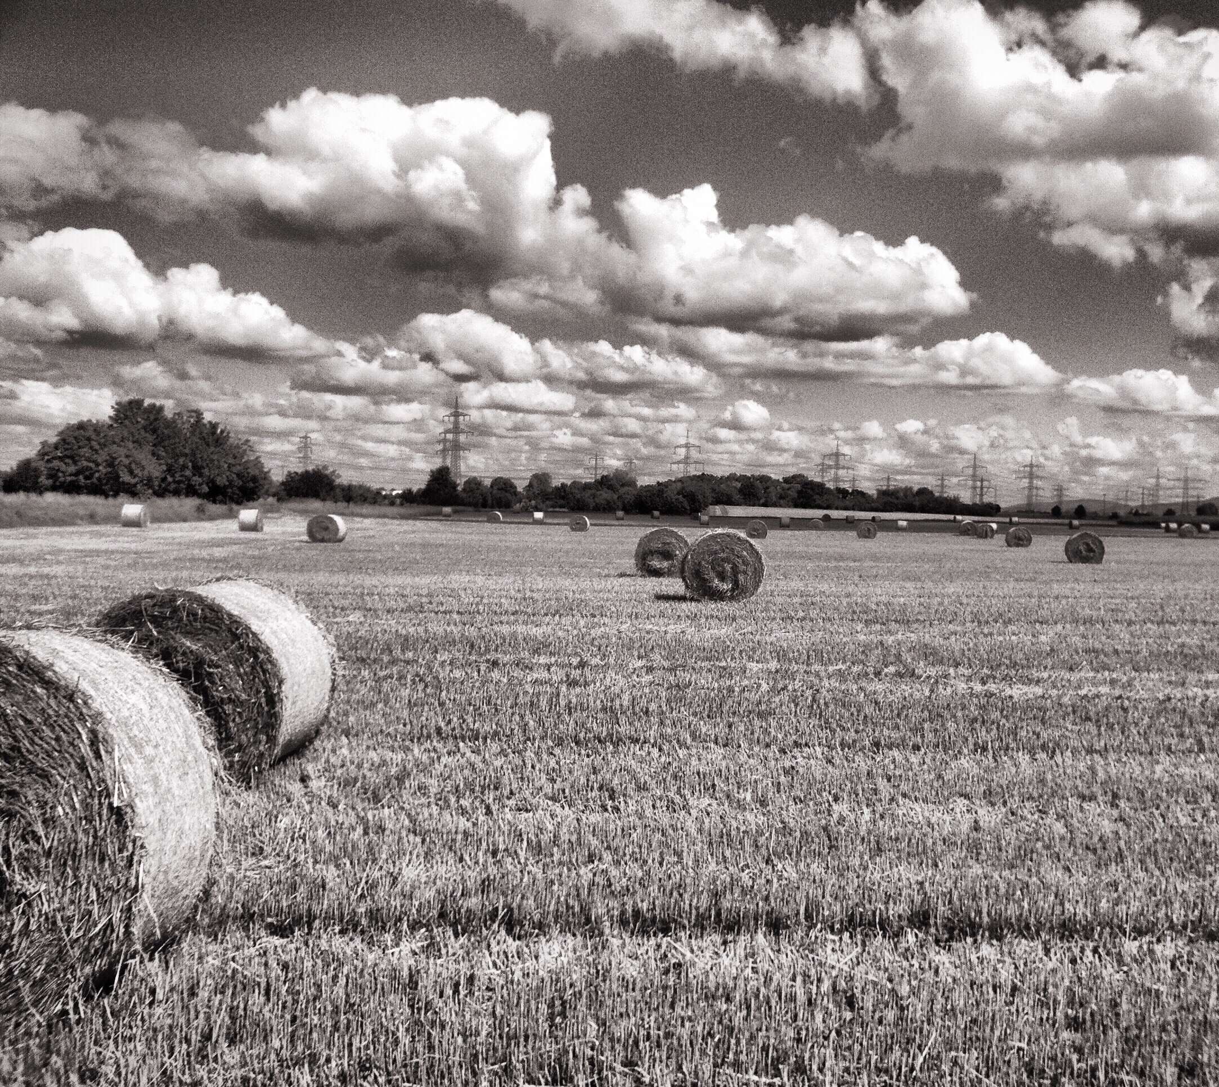
1. My Ordinary World Picture
"I thought my life was ok ..."

Slide 5
2. Inciting Incident Picture
"Suddenly ..."

Slide 6
3. Lost Balance/ Obstacles Picture
"When everything turned against me ..."

Slide 7
4. Despair Picture
"That was when I hit the bottom ..."

Slide 8
5. Revelation Picture
"But then I understood something ..."

Slide 9
6. Rise Picture
"Now I could ..."

Slide 10
7. New Life/ Higher Balance Picture
"What was missing in my old life was ..."

Slide 11
8. Lesson Learned Picture
"That is why you too should ..."

Slide 12
"Once you can express yourself, you can tell the world what you want from it ... All the changes in the world, for good or evil, were first brought about by words."
Jacqueline Kennedy Onassis

Slide 13
This high class
presentation advice
was brought to you by:
Become our sponsor!

