Slide 2
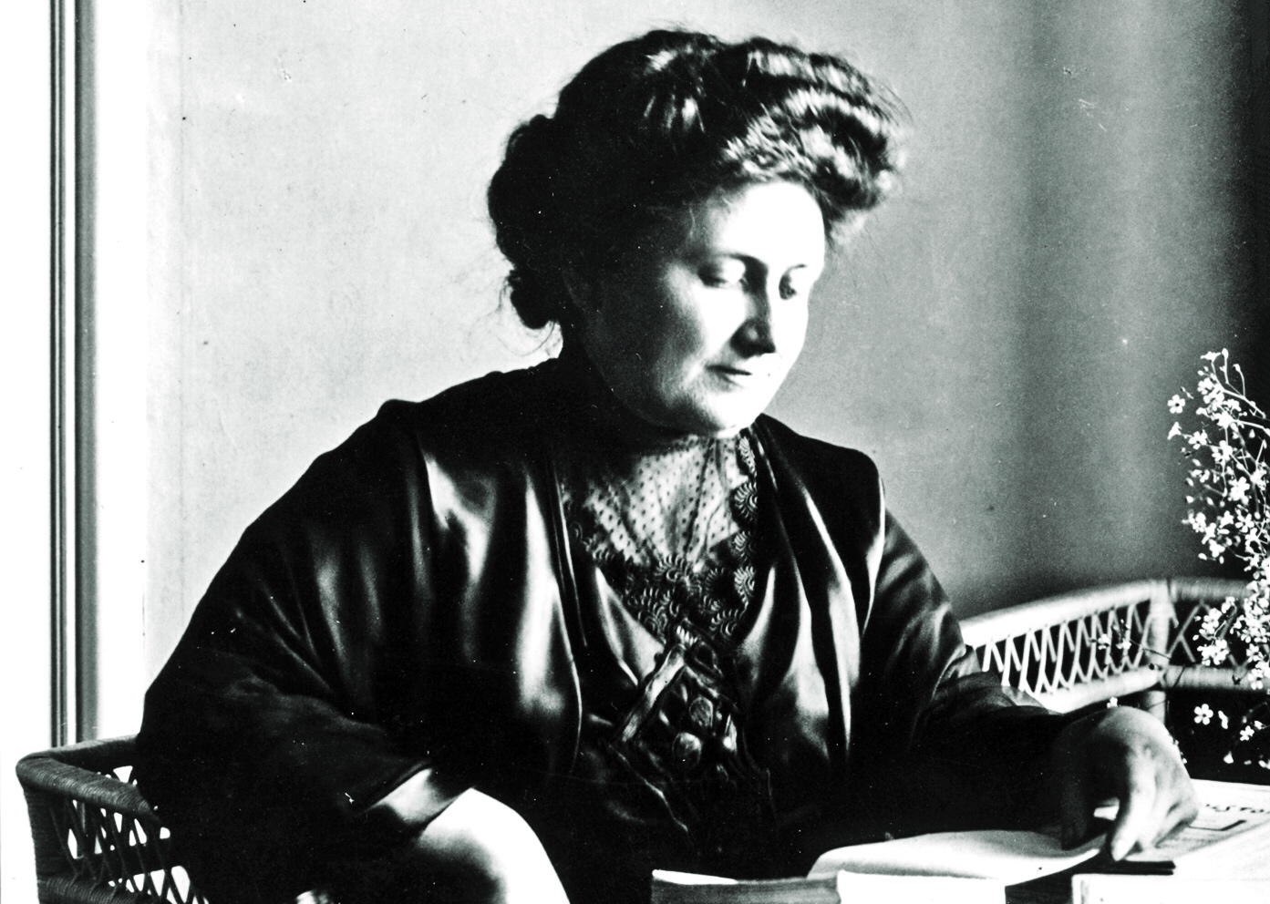
((c) Wikipedia / public domain

Slide 3
If you want to Explain how to become better at something, this Maria Montessori inspired Presentation Structure (9 slides) will help you to bring your audience to a higher level. In case the ability at hand is practical, you can use step 4 and step 6 as training sessions.
If you want to welcome your audience, do so between step 1 and step 2 (after slide 1). You can inflate every step with more slides, but try to avoid it. Remember: Presenting is an art and art is all about quality, not quantity.
Relevance Ability
Dimensions of Ability
Improvement Plan
Improvement Steps (or Exercises)
Recap
Future Implementation (or Exercise)
More on www.robertolalli.com

Slide 4
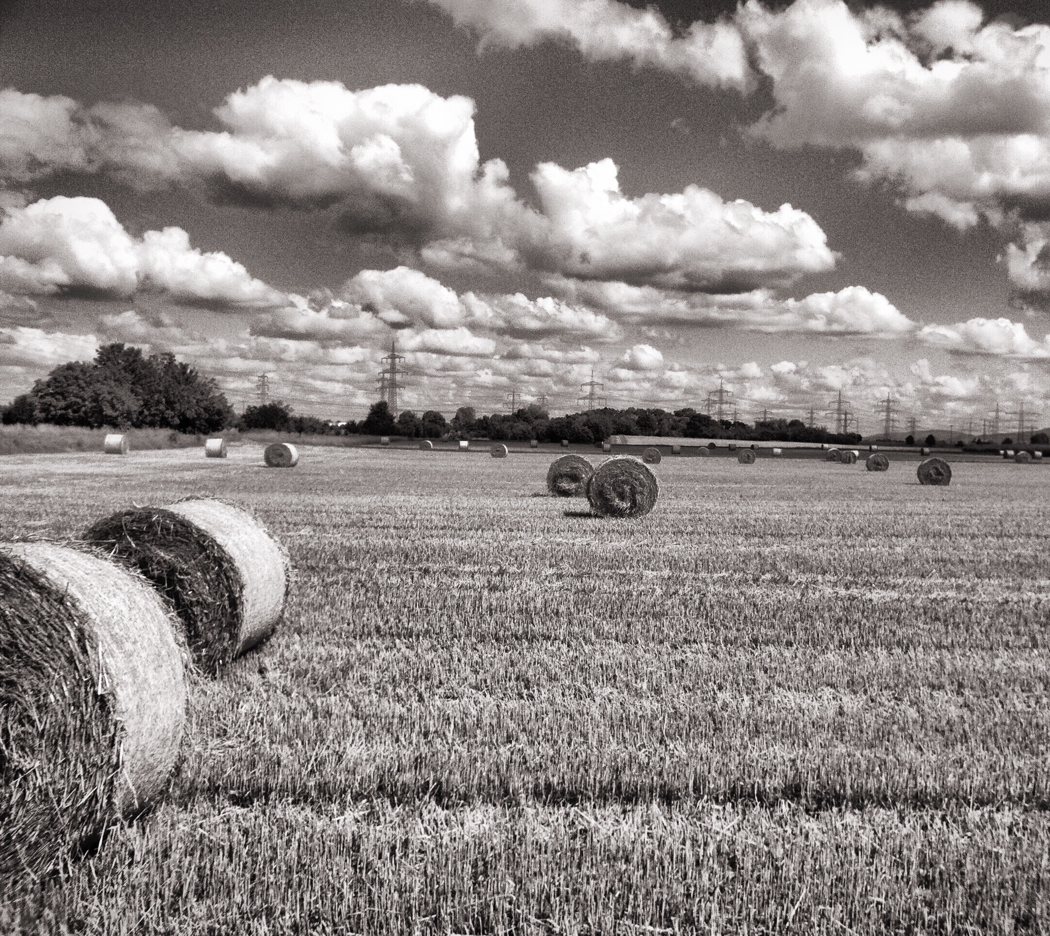
1. Relevance Ability Picture
"Why do we want to learn this?"

Slide 5
2. Dimensions of Ability Chart
"These are the relevant Dimensions ..."

Slide 6
3. Improvement Plan Chart
"This is what we are going to do ..."

Slide 7
Improvement 1st Step Picture
"Now, the first step we ..."

Slide 8
Improvement 2nd Step Picture
"Ok, the second step ..."

Slide 9
Improvement 3rd Step Picture
"Almost there, but ..."

Slide 10
5. Recap Chart
"Good. What have we learned?"

Slide 11
6. Future Implementation Picture
"In order to implement this ability ..."

Slide 12
"Do not tell them how to do it. Show them how to do it and do not say a word. If you tell them, they will watch your lips move. If you show them, they will want to do it themselves."
Maria Montessori

Slide 13
This high class
presentation advice
was brought to you by:
Become our sponsor!

